Slide 1

Testing and Debugging
The scientific process of debugging, the information problem, and the value in automated testing.
Kevin Lin, with thanks to many others.
Notes:
Ask questions anonymously on Piazza. Look for the pinned Lecture Questions thread.

Slide 2
Feedback from the Reading Quiz
Relatable list of incorrect assumptions. (Are assumptions bad?)
What does it mean to reproduce a bug?
How to write code so that it’s easier to debug.
“Debugging is twice as hard as writing the code in the first place. Therefore, if you write the code as cleverly as possible, you [won’t be able] to debug it.”
How to develop tests that cover the edge cases.
The Elements of Programming Style (Kernighan/McGraw-Hill)
Notes:
The reading discussed debugging practices with an emphasis on gathering information.

Slide 3
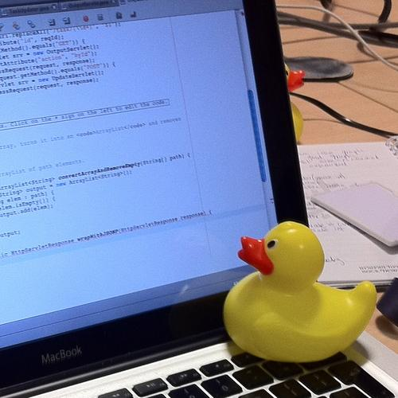
Real world analogues
Minimal working example
Rubber duck debugging
Scientific method
Rubber duck assisting with debugging (Tom Morris/Wikimedia)
Notes:
Experienced programmers can sometimes seem to solve problems almost intuitively because of how much practice they've had getting unstuck. While they get stuck just as often as you or me, they’ve exercised their problem-solving muscle enough to have an idea of which debugging strategy to try next. This learning doesn’t come immediately: it takes a lot of practice to develop these metacognitive skills.

Slide 4
ArrayQueue Demo

Slide 5
The Role of Information
The point here is that information is the most important thing and you need to do whatever’s necessary to get information.
How are bugs fixed? Here’s one proposal.
Productive changes fix bugs.
Information gathered about the system informs productive changes.
A hypothesis guides information gathering and testing.
Things we know about the problem inform how we choose hypotheses.
Information ???
3
A bug exists in the ArrayQueue isEmpty method.
2
ArrayQueue maintains certain invariants.
Unexpected result after add and remove.
1
What does debugging a program look like? (Julia Evans); The Debugging Mindset (Devon H. O’Dell/ACM Queue)
Notes:
?: Do we have reason to question the things we know about the problem? Or the hypothesis?

Slide 6
Generating Hypotheses
A good hypothesis identifies the cause of failure separately from where and when the program actually fails. The state of the ArrayQueue determines the behavior of isEmpty.
State
Information ???
Item[] data
int size
int front
int back
3
A bug exists in the ArrayQueue isEmpty method.
2
The Debugging Mindset (Devon H. O’Dell/ACM Queue)
Notes:
A good hypothesis describes a problem and is both testable and falsifiable. While this hypothesis is both, it doesn’t really yield much more information about the problem or how to fix it.

Slide 7
Descriptive Hypotheses
A good hypothesis identifies the cause of failure separate from where and when the program actually fails. The state of the ArrayQueue determines the behavior of isEmpty.
The hypothesis on the left suggests more about the problem than the one on the right.
The size variable is not set correctly, causing isEmpty to return false.
A bug exists in the ArrayQueue isEmpty method.
The Debugging Mindset (Devon H. O’Dell/ACM Queue)
Notes:
?: Why does the hypothesis on the left suggest more about the problem than the one on the right?

Slide 8
Tests as a Source of Information
ArrayQueue1<Integer> queue = new ArrayQueue1<>();
queue.add(1);
queue.remove();
queue.add(3);
queue.remove();
queue.remove();
queue.add(6);
queue.remove();
System.out.println( "isEmpty() expected true, got " + queue.isEmpty());
Notes:
?: What does this test check?

Slide 9
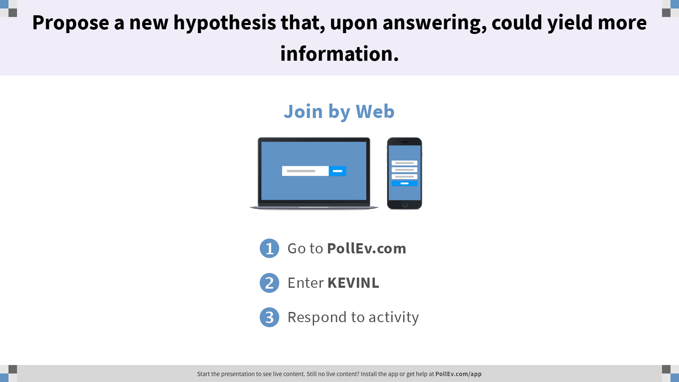
Propose a new hypothesis that, upon answering, could yield more information.

Slide 10
Hypotheses
Reference may cause the error in the program.
The method is unable to correctly remove elements from the data structure.
Two remove methods were used when there was only one value in the queue.
The remove is not used correctly.

Slide 11
Gathering Information
Notes:
Debugging is about integrating various different sources of information. Let’s try out a few methods of gathering information to understand the bug.
Trying new inputs.
Writing a unit test to reproduce the bug.
Explaining to yourself the behavior of each line of code.
Searching online to understand what error messages mean.
Changing or removing code.
Poking at memory values with a debugger or print statements.
?: Bugs often appear away from their root causes. How does each information gathering method help us learn more about the problem?

Slide 12
Ad-Hoc Testing
ArrayQueue1.main
ArrayQueue2.main
queue.add(1);
queue.remove();
queue.add(3);
queue.remove();
queue.remove();
queue.add(6);
queue.remove();
System.out.println( "..." + queue.isEmpty());
queue.add(0);
queue.remove();
queue.add(2);
queue.add(3);
queue.add(5);
queue.add(6);
System.out.println( "..." + queue.remove());

Slide 13
JUnit Testing
Notes:
Testing is a means of gathering information. But because unit tests are just programs, we can automate it and continuously gather information.

Slide 14
Simple JUnit Testing
ArrayQueueTest method
org.junit.Assert.assertEquals(expected, actual);
Call org.junit.Assert.assertEquals(...) to check that the expected equals the actual. If not, program terminates with a verbose message.
We can use this in place of writing out long print messages just to compare two arguments.
JUnit supports many more methods. (Check the online JUnit documentation for more.)
assertEquals
assertFalse
assertNotNull

Slide 15
Better JUnit Testing
ArrayQueueTest
@org.junit.Test
The messages output by JUnit are kind of ugly, and invoking each test manually is annoying.
IntelliJ has built-in support for JUnit.
Annotate each test (Java method) with @org.junit.Test.
Change all test methods to non-static.
Use IntelliJ’s built-in JUnit runner to run all tests and tabulate results.
This is called boilerplate code. IntelliJ can generate this code for you!
Notes:
To have IntelliJ generate the boilerplate code in a class ArrayQueue Test,
With the cursor placed somewhere inside the class’s curly braces, press Alt+Insert (on Windows/Linux) or Command+N (on Mac) to open the options for generating code.
In the pop-up menu, select “Test Method” and then choose the JUnit test option.
Fill in a name for the test.
Write the body of the test.
Protip: You can also generate all sorts of other boilerplate from this keyboard shortcut, such as “public static void main(String[] args)”.

Slide 16
Even Better JUnit Testing
ArrayQueueTest
import org.junit.Test;
import static org.junit.Assert.*;
Don’t want to type out the name of the library (org.junit.Test, org.junit.Assert.assertEquals)?
To workaround this annoyance, start every file with two import statements.

Slide 17
The Role of Information
The point here is that information is the most important thing and you need to do whatever’s necessary to get information.
How are bugs fixed? Here’s one proposal.
Productive changes fix bugs.
Information gathered about the system informs productive changes.
A hypothesis guides information gathering and testing.
Things we know about the problem inform how we choose hypotheses.
Two new regression tests
What does debugging a program look like? (Julia Evans); The Debugging Mindset (Devon H. O’Dell/ACM Queue)
Notes:
They’re called regression tests because we want to ensure that future changes don’t break these test cases that we know our program has had difficulty with in the past.

Slide 18
Testing as Planning
Q
Suppose we’re implementing ArrayQueue.
Describe a unit test we might want to write for ArrayQueue.
What behaviors does this test check? Describe in terms of the methods it checks as well as concepts like contracts, invariants, etc. that we’ve discussed in class.
Client
ADT
Implementer
Notes:
?: How did the ad-hoc tests for ArrayQueue1 and ArrayQueue2 expose particular bugs? What was special about those tests?
Q1: Describe a unit test we might want to write for ArrayDeque. Recall that the Deque interface expects methods such as addFirst, addLast, removeFirst, removeLast, and get.
Q2: What behaviors does this test check? Describe in terms of the methods it checks as well as concepts like contracts, invariants, etc. that we’ve discussed in class.

Slide 19
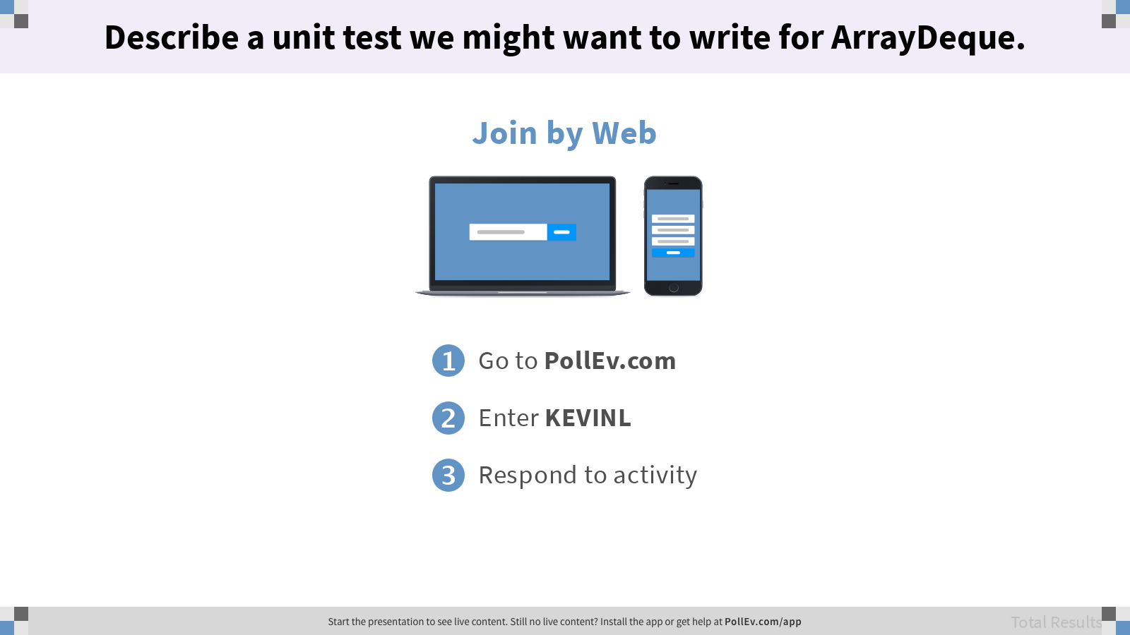
Describe a unit test we might want to write for ArrayDeque.

Slide 20
Testing as Planning
The point here is that information is the most important thing and you need to do whatever’s necessary to get information.
Not only does running a test improve our understanding of a problem, but so does writing a test!
Tests are hard to write, but easy to run.
Maximize the benefit of testing by writing tests first (or early) and code afterwards.
“I’m almost done, I just need to make sure it works.”
– Famous last words
What does debugging a program look like? (Julia Evans)
Notes:
If testing is left until after all of the code is written, we lose any opportunities to gather information along the way and fix bugs as they come up! We may even be solving the wrong problem altogether.
?: How does testing serve as a form of planning?
?: What makes writing good tests so challenging?

Slide 21
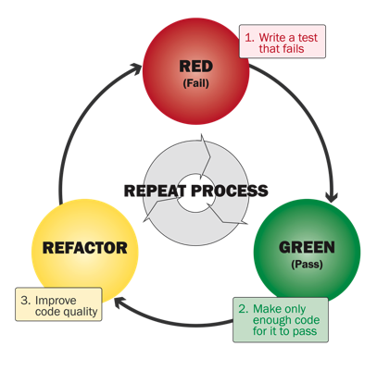
Test-Driven Development
The point here is that information is the most important thing and you need to do whatever’s necessary to get information.
Identify a new feature.
Write a unit test for that feature.
RED: Run the test. It should fail.
GREEN: Write code that passes test.
REFACTOR: Improve code quality.
What does debugging a program look like? (Julia Evans); Red-Shirt, Red, Green, Refactor - A TDD Fairytale (Ryan Tablada)
Notes:
?: Testing is just one tool in the information gathering toolbox. We’ve seen how testing can be a forming of planning. How do other information gathering methods inform our planning processes?

Slide 22

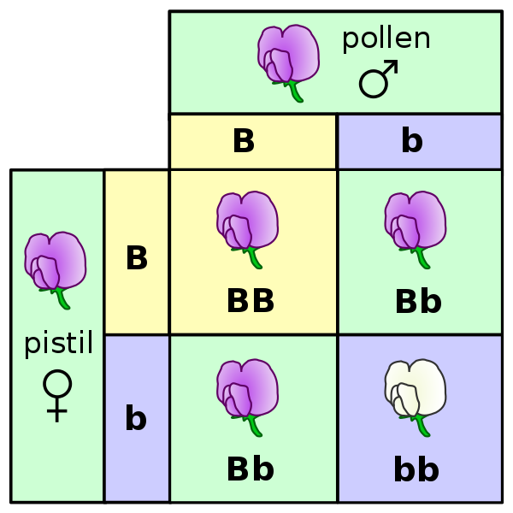


Running tests is virtually free compared to other sciences
Chemistry (~1 test/day)
Biology (~1 test/month)
Physics (~1 test/month+)
CS (1+ test/sec)
Algorithms (Robert Sedgewick, Kevin Wayne/Princeton)
Notes:
You can even automate your testing workflow so that every change to the code is automatically verified against the entire suite of unit tests to prevent regressions. Search for “Toggle auto-test”.

Slide 23
The Role of Information
The point here is that information is the most important thing and you need to do whatever’s necessary to get information.
How are bugs fixed? Here’s one proposal.
Productive changes fix bugs.
Information gathered about the system informs productive changes.
A hypothesis guides information gathering and testing.
Things we know about the problem inform how we choose hypotheses.
Modify the remove method to handle the special case of removing if empty.
3
The remove method decrements the size variable even when the queue is empty.
2
ArrayQueue maintains certain invariants.
Unexpected result after add and remove.
1
What does debugging a program look like? (Julia Evans); The Debugging Mindset (Devon H. O’Dell/ACM Queue)
Notes:
?: What are the differences between this new hypothesis and the hypothesis that we started with? How did we get from the starting hypothesis to this new hypothesis?

